Slide 1
Software Engineering Introduction
Dr. Kamal Beydoun
Faculty of Sciences I
Lebanese University
Programming today is a race between software engineers striving to build bigger and better idiot‐proof programs, and the universe trying to build bigger and better idiots. So far the universe is winning.
—Rick Cook

Slide 2

Introduction
The economies of ALL developed nations are dependent on software.
More and more systems are software controlled.

Slide 3
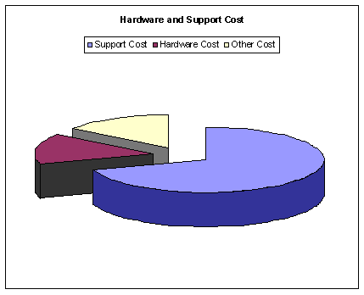
Introduction
Software costs often dominate computer system costs.
The costs of software on a PC are often greater than the hardware cost.
Software costs more to maintain than it does to develop.
For systems with a long life, maintenance costs may be several times development costs.
Microsoft Word, for example, has been evolving for roughly 30 years.

Slide 4
What is Software Engineering?
“An organized, analytical approach to the design, development, use, and maintenance of software”
-- Rod Stephens, Beginning Software Engineering
“Software engineering is an engineering discipline that is concerned with all aspects of software production.”
-- I. Sommerville, Software Engineering
Software engineering is everything you need to do to produce successful software from the early stages of system specification through to maintaining the system after it has gone into use.
Notes:
Unfortunately, the flexibility that allows you to make changes throughout a software project’s life cycle also lets you mess things up at any point during development. Adding a new feature can break
existing code or turn a simple, elegant design into a confusing mess. Constantly adding, removing, and modifying features during development can make it impossible for different parts of the system to work together. In some cases, it can even make it impossible to tell when the project is finished.

Slide 5
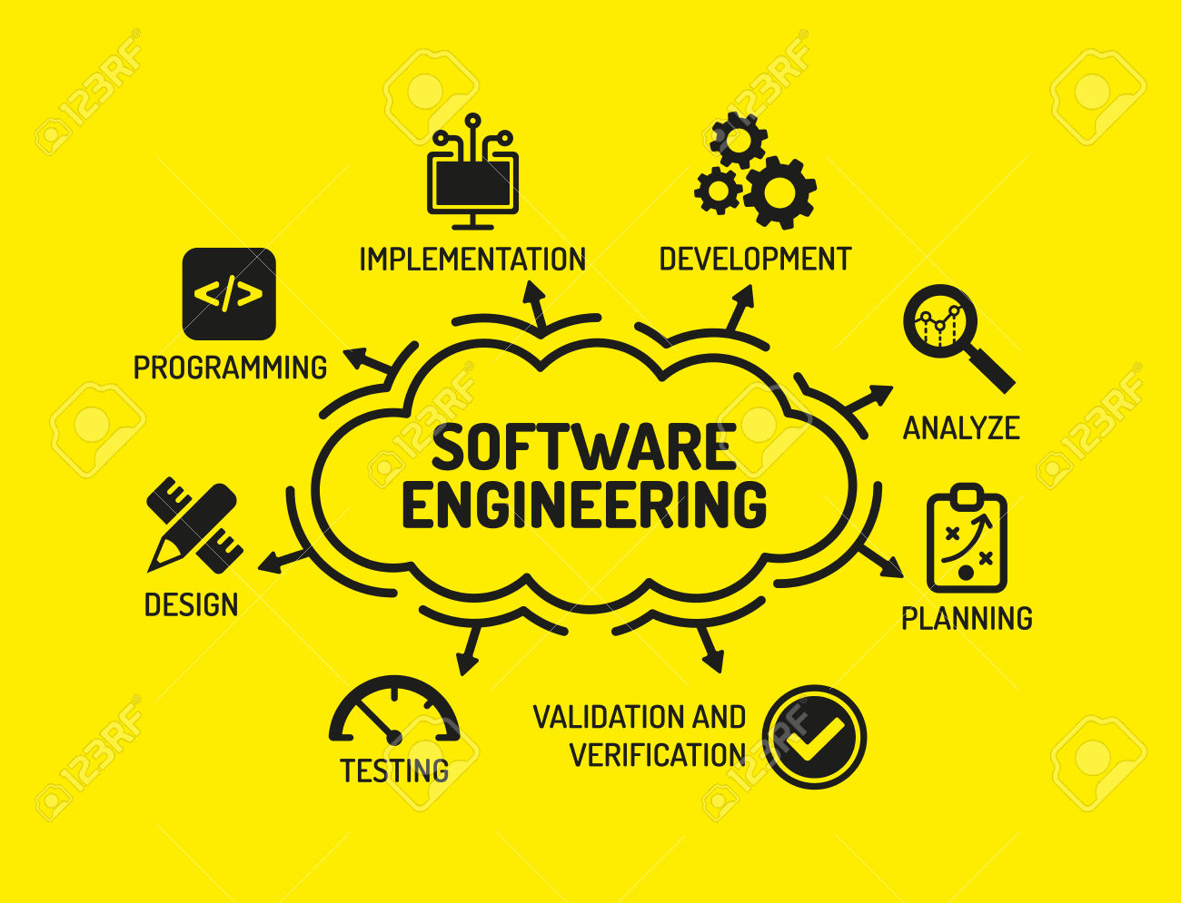
Why Is Software Engineering Important?
Software engineering includes techniques for avoiding many drawbacks that might send your project down the road to failure.
It ensures the final application is effective, usable, and maintainable.
software engineering gives you the flexibility to make changes to meet unexpected demands without completely obliterating your schedule and budget constraints.

Slide 6
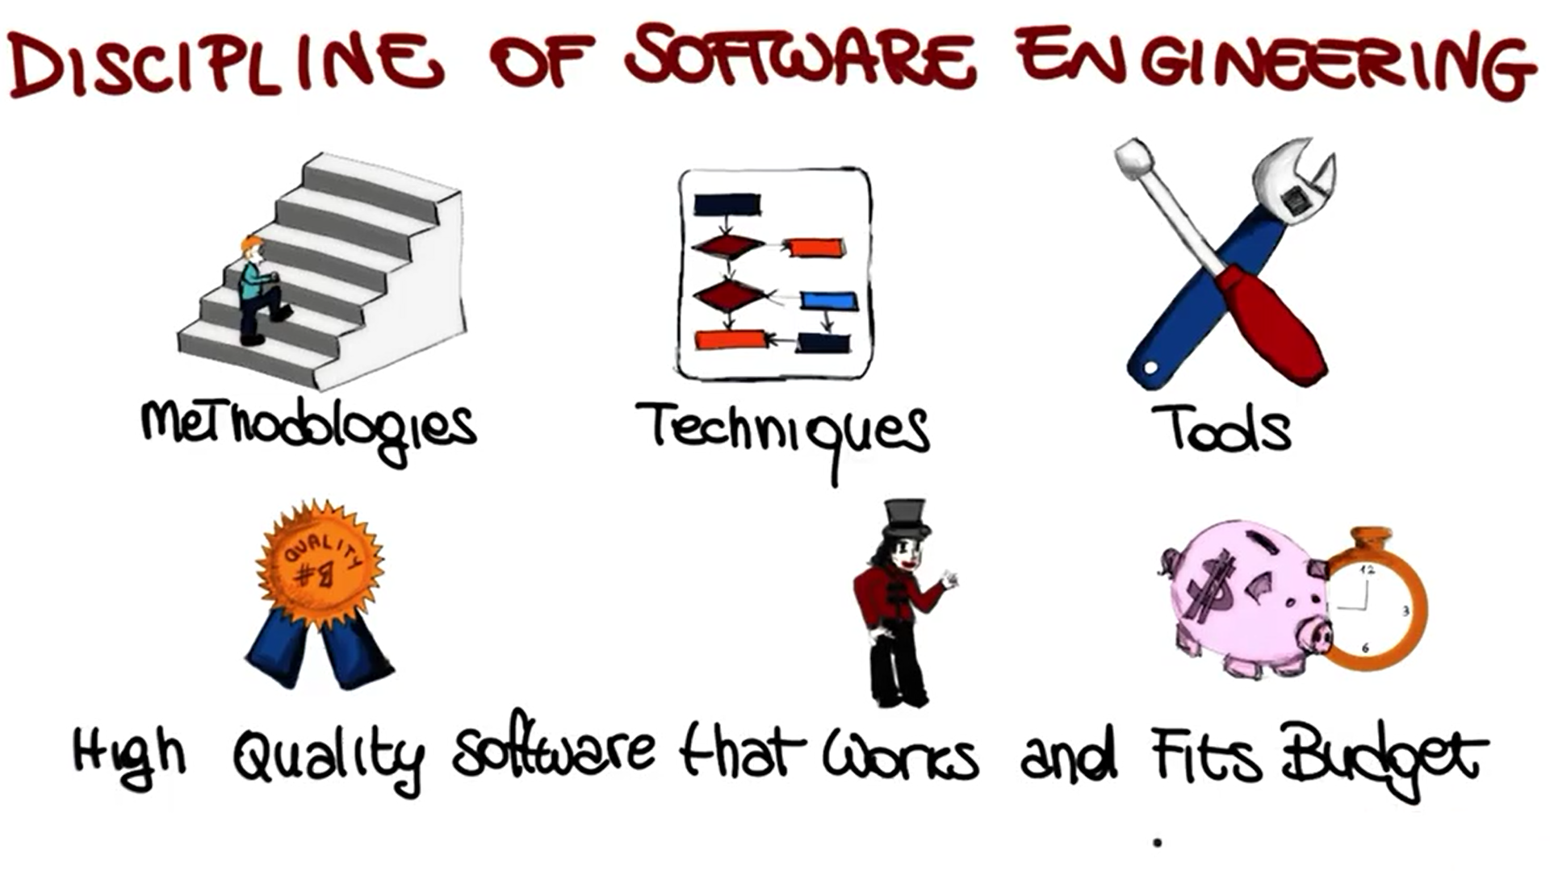

Slide 7
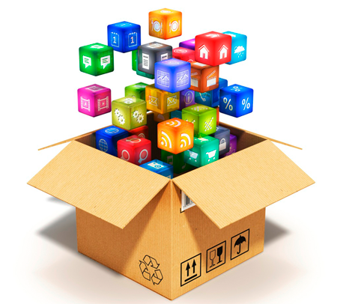
Software products
Generic products
Stand-alone systems that are marketed and sold to any customer who wishes to buy them.
Examples – PC software such as graphics programs, project management tools.
Customized products
Software that is commissioned by a specific customer to meet their own needs.
Examples – embedded control systems, air traffic control software, traffic monitoring systems.
Notes:
CAD technology is used in the design of tools and machinery and in the drafting and design of all types of buildings, from small residential types (houses)

Slide 8
General issues that affect most software
Heterogeneity
Increasingly, systems are required to operate as distributed systems across networks that include different types of computer and mobile devices.
Business and social change
Business and society are changing incredibly quickly as emerging economies develop and new technologies become available. They need to be able to change their existing software and to rapidly develop new software.
Security and trust
As software is intertwined with all aspects of our lives, it is essential that we can trust that software.

Slide 9
Frequently asked questions about software engineering
Question | Answer
What is software? | Computer programs and associated documentation. Software products may be developed for a particular customer or may be developed for a general market.
What are the attributes of good software? | Good software should deliver the required functionality and performance to the user and should be maintainable, dependable and usable.
What is software engineering? | Software engineering is an engineering discipline that is concerned with all aspects of software production.
What are the fundamental software engineering activities? | Software specification, software development, software validation and software evolution.
What is the difference between software engineering and computer science? | Computer science focuses on theory and fundamentals; software engineering is concerned with the practicalities of developing and delivering useful software.
What is the difference between software engineering and system engineering? | System engineering is concerned with all aspects of computer-based systems development including hardware, software and process engineering. Software engineering is part of this more general process.

Slide 10
Frequently asked questions about software engineering
Question | Answer
What are the key challenges facing software engineering? | Coping with increasing diversity, demands for reduced delivery times and developing reliable software.
What are the costs of software engineering? | Roughly 60% of software costs are development costs, 40% are testing costs. For custom software, evolution costs often exceed development costs.

Slide 11
Essential attributes of good software
Product characteristic | Description
Maintainability | Software should be written in such a way so that it can evolve to meet the changing needs of customers. This is a critical attribute because software change is an inevitable requirement of a changing business environment.
Dependability and security | Software dependability includes a range of characteristics including reliability, security and safety. Dependable software should not cause physical or economic damage in the event of system failure. Malicious users should not be able to access or damage the system.
Efficiency | Software should not make wasteful use of system resources such as memory and processor cycles. Efficiency therefore includes responsiveness, processing time, memory utilisation, etc.
Acceptability | Software must be acceptable to the type of users for which it is designed. This means that it must be understandable, usable and compatible with other systems that they use.

Slide 12
Application types
Stand-alone applications
These are application systems that run on a local computer, such as a PC. They include all necessary functionality and do not need to be connected to a network.
Interactive transaction-based applications
Applications that execute on a remote computer and are accessed by users from their own PCs or terminals. These include web applications such as e-commerce applications.
Embedded control systems
These are software control systems that control and manage hardware devices. Numerically, there are probably more embedded systems than any other type of system.

Slide 13
Application types
Batch (Collection) processing systems
These are business systems that are designed to process data in large batches. They process large numbers of individual inputs to create corresponding outputs.
Entertainment systems
These are systems that are primarily for personal use and which are intended to entertain the user (games).
Systems for modelling and simulation
These are systems that are developed by scientists and engineers to model physical processes or situations, which include many, separate, interacting objects.
Notes:
Btach processing systems: salary billing systems
Batch: Collection
Entertain: amuse

Slide 14
Application types
Data collection systems
These are systems that collect data from their environment using a set of sensors and send that data to other systems for processing.
Systems of systems
These are systems that are composed of a number of other software systems.

Slide 15

Videos - Quiz

Slide 16

Videos – Answer to Quiz

Slide 17

Videos – Discipline of SE

Slide 18

Videos – Software Engineering Crisis

Slide 19
Videos - Software Engineering Crisis Quiz

Slide 20
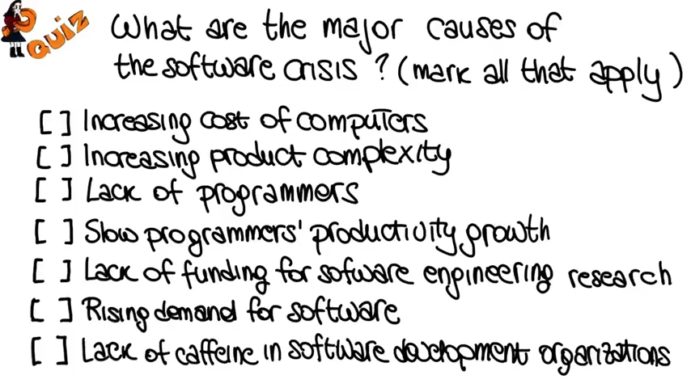
Videos - Software Engineering Crisis Answer to Quiz

Slide 21

Videos- Evidence of Software Engineering Crisis

Slide 22

Videos – Software Development

